Slide 1
MA3077 (DLI) Operational Research Lecture 27 – Penalty and augmented Lagrangian Methods
Dr Marco Fasondini

Slide 2
Recap and plan of the day
Recap: in the previous lecture we learnt:
the fundamentals of nonlinear constrained optimisation
the first-order necessary conditions for optimality (KKT conditions)
In this lecture: We discuss practical algorithms to solve (at least approximately) nonlinear constrained optimisation problems. We follow closely Ch. 17 of the book Numerical Optimization by Jorge Nocedal and Stephen J. Wright.

Slide 3
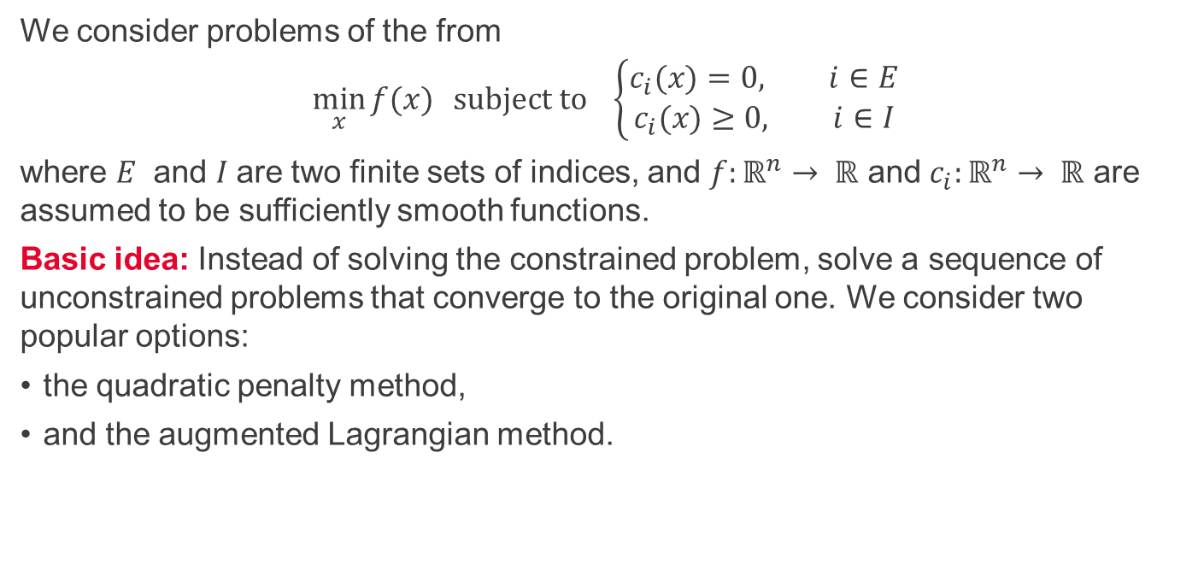
Constrained optimisation
We consider problems of the from
$$\min_{x}{f(x)} subject to \left\{\begin{aligned}c_{i}(x)=0, i∈E \\ &c_{i}(x)≥0, i∈I\end{aligned}\right.$$
where $E$ and $I$are two finite sets of indices, and $f:ℝ^{n}→ ℝ$ and $c_{i}:ℝ^{n}→ ℝ$ are assumed to be sufficiently smooth functions.
Basic idea: Instead of solving the constrained problem, solve a sequence of unconstrained problems that converge to the original one. We consider two popular options:
the quadratic penalty method,
and the augmented Lagrangian method.

Slide 4
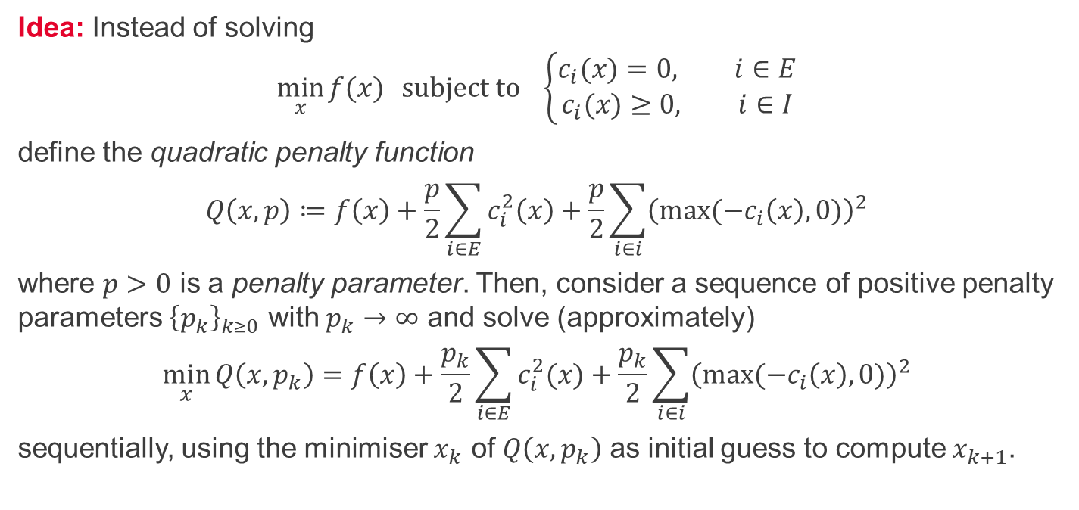
The quadratic penalty method
Idea: Instead of solving
$$\min_{x}{f(x)} subject to \left\{\begin{aligned}c_{i}(x)=0, i∈E \\ &c_{i}(x)≥0, i∈I\end{aligned}\right.$$
define the quadratic penalty function
$$Q\left(x,p\right)≔f\left(x\right)+\frac{p}{2}\sum_{i∈E}{c_{i}^{2}\left(x\right)}+\frac{p}{2}\sum_{i∈i}{{\left(max⁡({−c}_{i}\left(x\right), 0)\right)}^{2}}$$
where $p>0$ is a penalty parameter. Then, consider a sequence of positive penalty parameters ${\left\{p_{k}\right\}}_{k≥0}$ with $p_{k}→∞$ and solve (approximately)
$$\min_{x}{Q\left(x,p_{k}\right)=f\left(x\right)+\frac{p_{k}}{2}\sum_{i∈E}{c_{i}^{2}(x)}}+\frac{p_{k}}{2}\sum_{i∈i}{{\left(max⁡({−c}_{i}\left(x\right), 0)\right)}^{2}}$$
sequentially, using the minimiser $x_{k}$ of $Q\left(x,p_{k}\right)$ as initial guess to compute $x_{k+1}$.

Slide 5
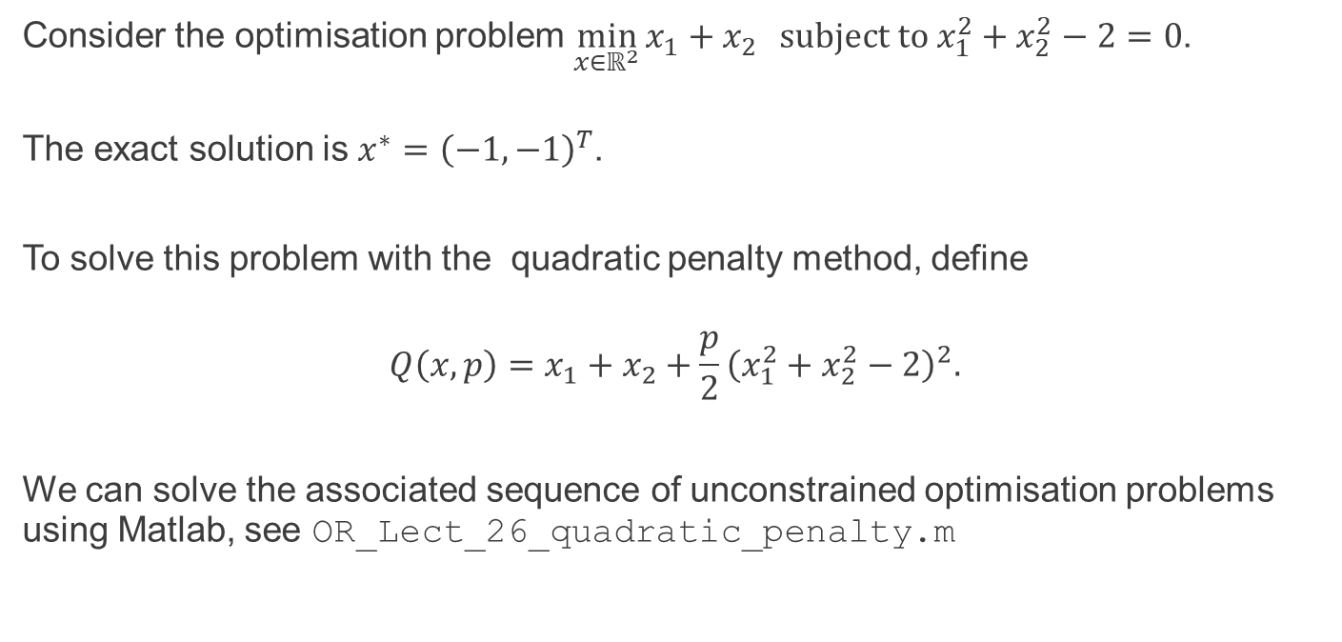
The quadratic penalty method - example
Consider the optimisation problem $\min_{x∈ℝ^{2}}{x_{1}+x_{2}} subject to x_{1}^{2}+x_{2}^{2}−2=0$.
The exact solution is $x^{∗}={\left(−1,−1\right)}^{T}$.
To solve this problem with the quadratic penalty method, define
$$Q\left(x,p\right)=x_{1}+x_{2}+\frac{p}{2}{\left(x_{1}^{2}+x_{2}^{2}−2\right)}^{2}.$$
We can solve the associated sequence of unconstrained optimisation problems using Matlab, see OR_Lect_26_quadratic_penalty.m

Slide 6
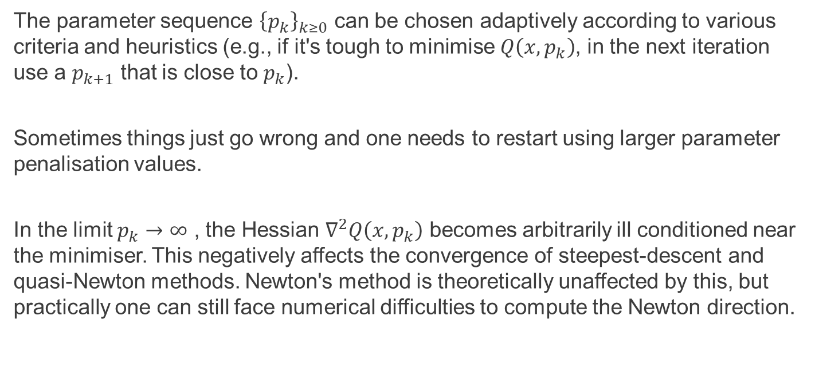
The quadratic penalty method – penalty selection
The parameter sequence ${\left\{p_{k}\right\}}_{k≥0}$ can be chosen adaptively according to various criteria and heuristics (e.g., if it's tough to minimise $Q\left(x,p_{k}\right)$, in the next iteration use a $p_{k+1}$ that is close to $p_{k}$).
Sometimes things just go wrong and one needs to restart using larger parameter penalisation values.
In the limit $p_{k}→∞$ , the Hessian $∇^{2}Q\left(x,p_{k}\right)$ becomes arbitrarily ill conditioned near the minimiser. This negatively affects the convergence of steepest-descent and quasi-Newton methods. Newton's method is theoretically unaffected by this, but practically one can still face numerical difficulties to compute the Newton direction.

Slide 7
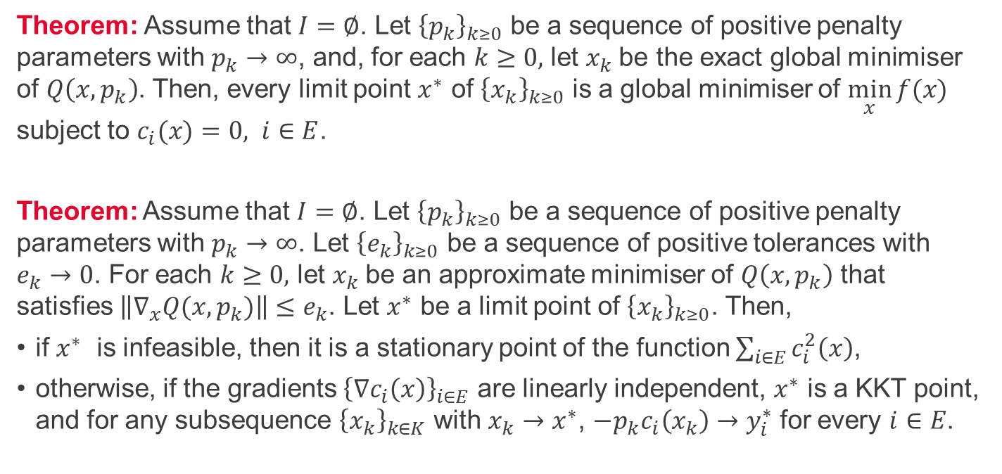
The quadratic penalty method - convergence
Theorem: Assume that $I=∅$. Let ${\left\{p_{k}\right\}}_{k≥0}$ be a sequence of positive penalty parameters with $p_{k}→∞$, and, for each $k≥0,$ let $x_{k}$be the exact global minimiser of $Q\left(x,p_{k}\right)$. Then, every limit point $x^{∗}$ of ${\left\{x_{k}\right\}}_{k≥0}$ is a global minimiser of $\min_{x}{f(x)}$ subject to $c_{i}(x)=0, i∈E$.
Theorem: Assume that $I=∅$. Let ${\left\{p_{k}\right\}}_{k≥0}$ be a sequence of positive penalty parameters with $p_{k}→∞$. Let ${\left\{e_{k}\right\}}_{k≥0}$ be a sequence of positive tolerances with $e_{k}→0$. For each $k≥0,$ let $x_{k}$be an approximate minimiser of $Q\left(x,p_{k}\right)$ that satisfies $\left\|∇_{x}Q(x,p_{k})\right\|≤e_{k}$. Let $x^{∗}$ be a limit point of ${\left\{x_{k}\right\}}_{k≥0}$. Then,
if $x^{∗}$ is infeasible, then it is a stationary point of the function $\sum_{i∈E}{c_{i}^{2}\left(x\right)}$,
otherwise, if the gradients ${\left\{∇c_{i}\left(x\right)\right\}}_{i∈E}$ are linearly independent, $x^{∗}$ is a KKT point, and for any subsequence ${\left\{x_{k}\right\}}_{k∈K}$ with $x_{k}→x^{∗}$, $−p_{k}c_{i}\left(x_{k}\right)→y_{i}^{∗}$ for every $i∈E$.

Slide 8
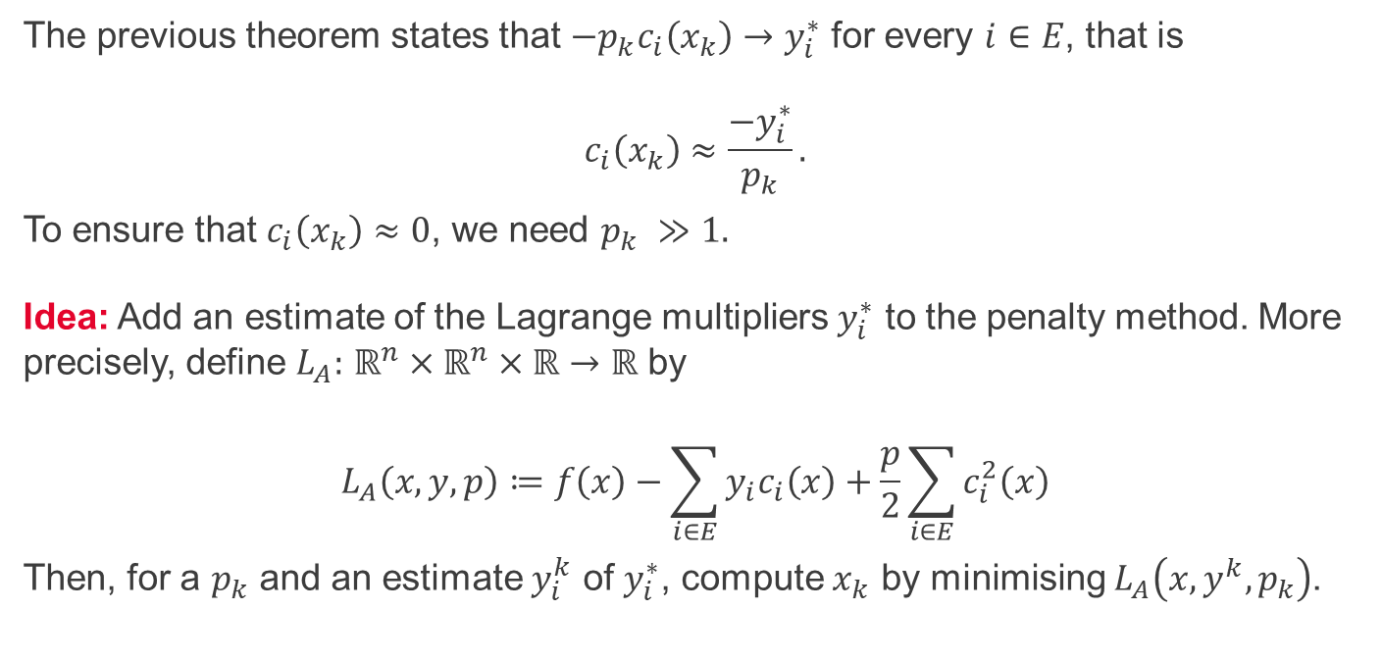
Augmented Lagrangian method - idea
The previous theorem states that $−p_{k}c_{i}\left(x_{k}\right)→y_{i}^{∗}$ for every $i∈E$, that is $$c_{i}\left(x_{k}\right)≈\frac{{−y}_{i}^{∗}}{p_{k}}.$$
To ensure that $c_{i}\left(x_{k}\right)≈0$, we need $p_{k} ≫1.$ $\text{Idea}\text{:}$ Add an estimate of the Lagrange multipliers $y_{i}^{∗}$ to the penalty method. More precisely, define $L_{A}:$ $ℝ^{n}×ℝ^{n}×ℝ→ℝ$ by
$$L_{A}\left(x,y,p\right)≔f\left(x\right)−\sum_{i∈E}{y_{i}c_{i}\left(x\right)}+\frac{p}{2}\sum_{i∈E}{c_{i}^{2}\left(x\right)}$$
Then, for a $p_{k}$ and an estimate $y_{i}^{k}$ of $y_{i}^{∗}$, compute $x_{k}$ by minimising $L_{A}\left(x,y^{k},p_{k}\right)$.

Slide 9
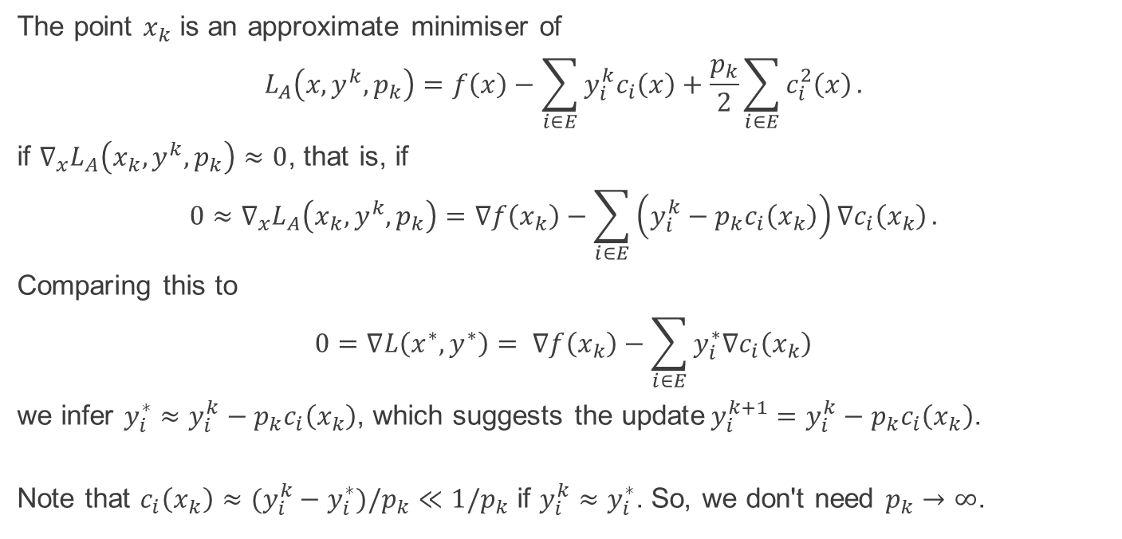
Augmented Lagrangian method – update of $y^{k}$
The point $x_{k}$ is an approximate minimiser of
$$L_{A}\left(x,y^{k},p_{k}\right)=f\left(x\right)−\sum_{i∈E}{y_{i}^{k}c_{i}\left(x\right)}+\frac{p_{k}}{2}\sum_{i∈E}{c_{i}^{2}\left(x\right)}.$$
if ${∇_{x}L}_{A}\left(x_{k},y^{k},p_{k}\right)≈0$, that is, if
$$0≈{∇_{x}L}_{A}\left(x_{k},y^{k},p_{k}\right)=∇f\left(x_{k}\right)−\sum_{i∈E}{\left(y_{i}^{k}−p_{k}c_{i}\left(x_{k}\right)\right)∇c_{i}\left(x_{k}\right)}.$$
Comparing this to
$$0=∇L\left(x^{∗}, y^{∗}\right)= ∇f\left(x_{k}\right)−\sum_{i∈E}{y_{i}^{∗}∇c_{i}\left(x_{k}\right)}$$
we infer $y_{i}^{∗}≈y_{i}^{k}−p_{k}c_{i}\left(x_{k}\right)$, which suggests the update$y_{i}^{k+1}=y_{i}^{k}−p_{k}c_{i}\left(x_{k}\right)$.
Note that $c_{i}\left(x_{k}\right)≈{(y_{i}^{k}−y}_{i}^{∗})/p_{k}≪1/p_{k}$ if ${y_{i}^{k}≈y}_{i}^{∗}$. So, we don't need $p_{k}→∞$.

Slide 10
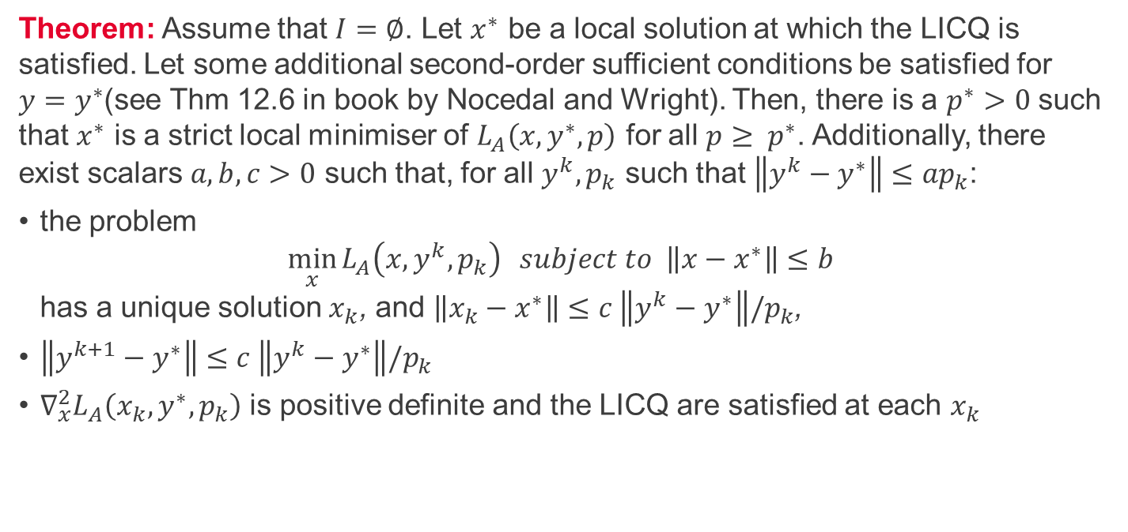
Augmented Lagrangian method - convergence
Theorem: Assume that $I=∅$. Let $x^{∗}$ be a local solution at which the LICQ is satisfied. Let some additional second-order sufficient conditions be satisfied for $y=y^{∗}$(see Thm 12.6 in book by Nocedal and Wright). Then, there is a $p^{∗}>0$ such that $x^{∗}$ is a strict local minimiser of $L_{A}\left(x,y^{∗},p\right)$ for all $p≥ p^{∗}$. Additionally, there exist scalars $a,b,c>0$ such that, for all $y^{k},p_{k}$ such that $\left\|y^{k}−y^{∗}\right\|≤{ap}_{k}$:
the problem $\min_{x}{L_{A}\left(x,y^{k},p_{k}\right)} subject to \left\|x−x^{∗}\right\|≤b$ has a unique solution $x_{k}$, and $\left\|x_{k}−x^{∗}\right\|≤c \left\|y^{k}−y^{∗}\right\|/p_{k}$,
$\left\|y^{k+1}−y^{∗}\right\|≤c \left\|y^{k}−y^{∗}\right\|/p_{k}$
${∇_{x}^{2}L}_{A}\left(x_{k},y^{∗},p_{k}\right)$ is positive definite and the LICQ are satisfied at each $x_{k}$

Slide 11
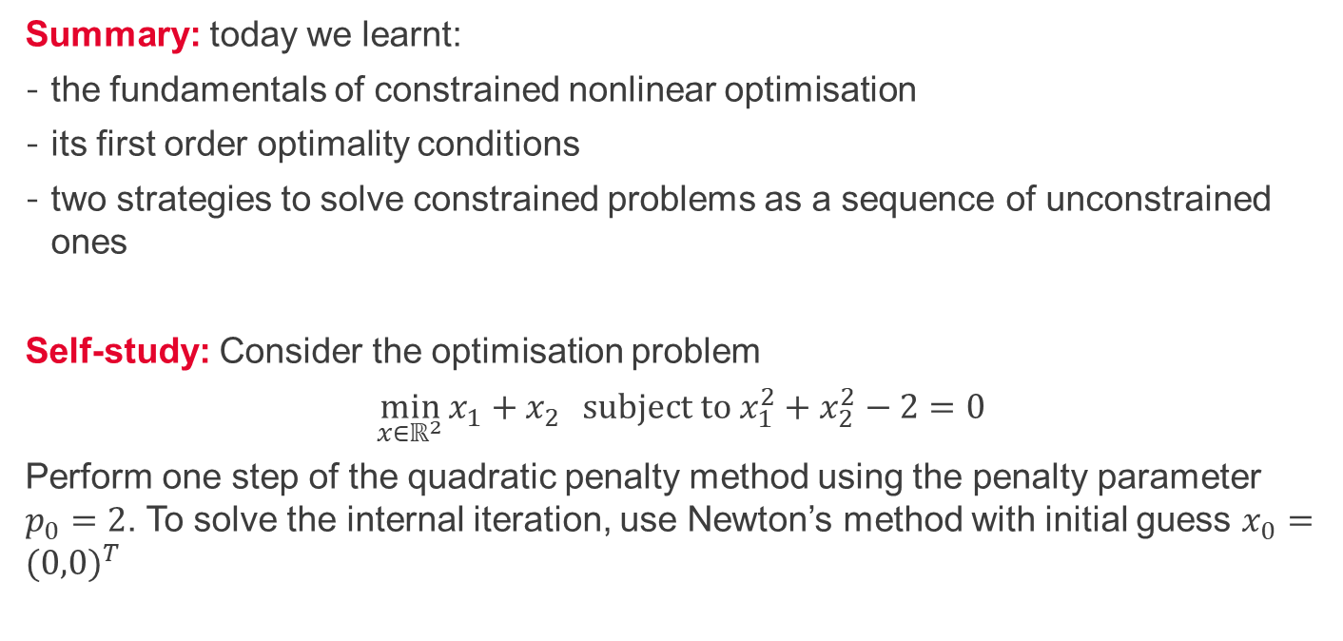
Summary and self-study
Summary: today we learnt:
the fundamentals of constrained nonlinear optimisation
its first order optimality conditions
two strategies to solve constrained problems as a sequence of unconstrained ones
Self-study: Consider the optimisation problem
$\min_{x∈ℝ^{2}}{x_{1}+x_{2}} subject to x_{1}^{2}+x_{2}^{2}−2=0$
Perform one step of the quadratic penalty method using the penalty parameter $p_{0}=2$. To solve the internal iteration, use Newton’s method with initial guess $x_{0}={(0,0)}^{T}$

